Slide 1

Crypto-currency market analysis
using social media data
PRESENTED BY:
Group 3
Azhar - Karan - Yasin

Slide 2

Overview
Background
Research Questions
Data Collection
Data Processing
Data Visualization and Summarization
Regression Analysis and Predictions
Conclusion

Slide 3



Team Work
Azharul Islam
PhD in Computer Science - MST
Contribution : Business Case, Data Cleansing and manipulations, Project Visualizations, Suggested benefits for investors
Karan Madra
MS in Information Science & Technology - MST
Contribution : Project Setting, Research Questions, Analysis of Project visualizations, Key Findings
Md Yasin Kabir
PhD in Computer Science - MST
Contribution : Business Scenario, Data Collection, Data Manipulation, Data Visualizations, Project conclusions

Slide 4

Project Background & Research Questions

Slide 5
Background
Cryptocurrency is a digital or virtual currency designed to work as a medium of exchange.
All crypto-currencies are powered by a distributed immutable public database called BlockChain
Any transaction ever made in crypto-currency is written in the BlockChain and can be easily verified by anyone.
Bitcoin is the first cryptocurrency and currently has the largest market cap

Slide 6
Background (contd)
There is no central authority to regulate the crypto-currency market and is extremely volatile in nature
Opinions and information about cryptocurrency in the news and social media sphere are prevalent to its price fluctuation
Our team worked towards processing the data from twitter and showed how it affects the crypto-currency market

Slide 7

Research Questions
What are the words which frequently used in the tweets about the cryptocurrency?
What are the location distribution the users who tweets related to the cryptocurrency?
How many tweets are tweeted in a specific timeframe regarding cryptocurrency and how it influence the price?
Can the famous twitter or verified users have significant influence over the price?
Is there any correlation between sentiment of the tweets and cryptocurrency price trend?
Is it possible to build a prediction model based on the social media data and cryptocurrency price history data that can predict the price with accuracy?

Slide 8

Data Collection and Manipulation

Slide 9

Data Collection
TWITTER:
Used twitter streaming API and collected data using various crypto-currencies related keyword such as "crypto, cryptocurrency, bitcoin, #bitcoin, btc, #btc, eth, #eth, #ethereum, etc."
Used python and R for achieving better datasets
Collected more than 7 millions tweets in this steps and stored as JSON.
Later we cleaned up those data to reduce noise, duplication and irrelevant information using python

Slide 10

Crypto-Currency Market Data
API used: https://www.cryptocompare.com/
Collected hourly and minute data for 15 days
price
high
low
volume
time

Slide 11
Data Processing
Collected more than 7 million tweets for two weeks of time frame.
Size of the tweets was more than 43GB
Divided the data set, extracted the useful columns, merged dataset based on the columns
After merging retained only 20 files (less than 10GB in size)
Also stored data as MSGPACKS which allowed us to further compress the data
Selected more than 2M tweets for 5 days timeframe
Grouped the tweets by 2min timeframe and managed to get around 3000 observations for the master data file.

Slide 12
Master Data File Creation
Grouped in 2 and 5 minutes time range
2 min data group was found to be better for regression and prediction analysis
Analyzed the tweet text and extracted sentiment polarity score using textblob
We processed the tweets user information and extracted 5 variables ( 'user_followers_count', 'user_friends_count', 'user_verified', 'no_users', and 'avg_id_age_days') columns
Similar processes were carried out to determine ‘Tweets User’ and ‘Price’
Three files (price data, tweets text data, and tweets user data) were combined to create the master file.

Slide 13

Data Analysis

Slide 14
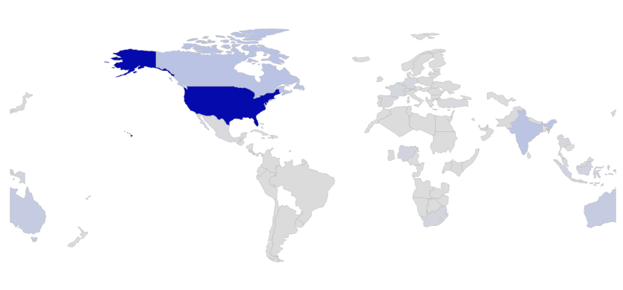
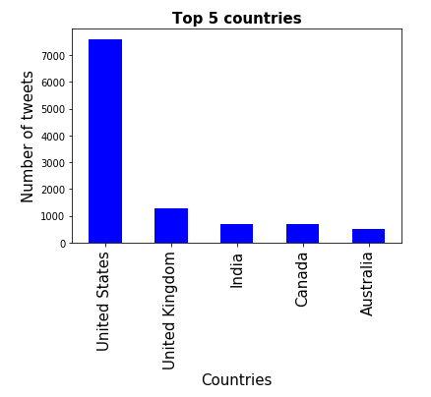
From the above map we can observe the user distribution over the world
USA out number all the other countries.
More 60% of the tweets came from United States followed by United Kingdom and India.
Crypto-currency is fairly a new term for many of the asian countries.
User Location Distribution

Slide 15
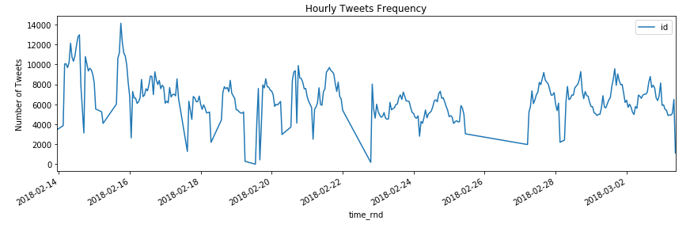
Lesser price fluctuations were observed during weekends.
Users were proactive to post about the bitcoin during the weekdays in comparison to the weekends
Hourly Tweets Frequency

Slide 16
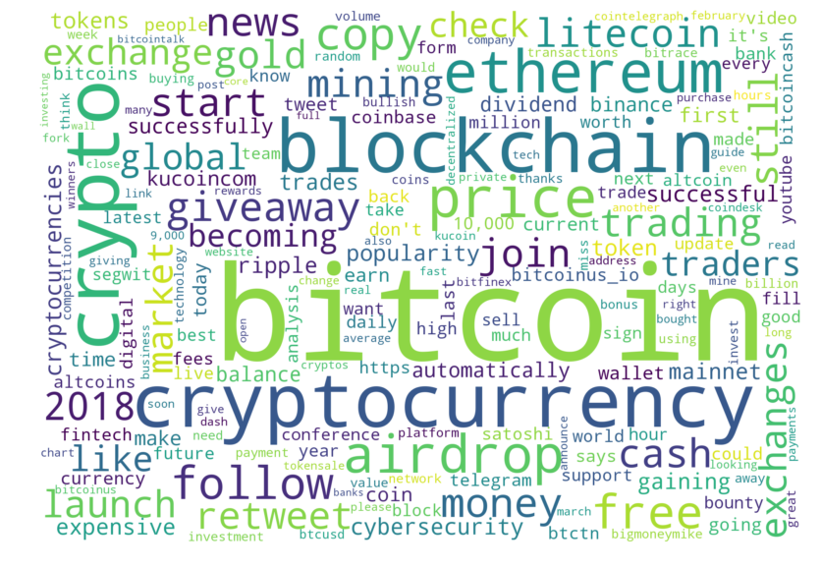
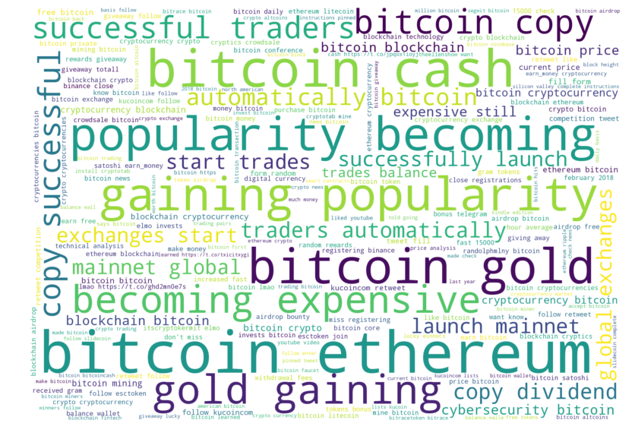
Frequent bigram provided better insight than word cloud
Some bigrams (e.g. gaining pop
ularity, mainnet global, launch mainnet, blockchain fintech, cybersecurity bitcoin, silicon valley, bitcoin airdrop, binance close, invest bitcoin, popularity becoming, bitcoin conference, might banned) can impact price.
Tweet Text Analysis

Slide 17
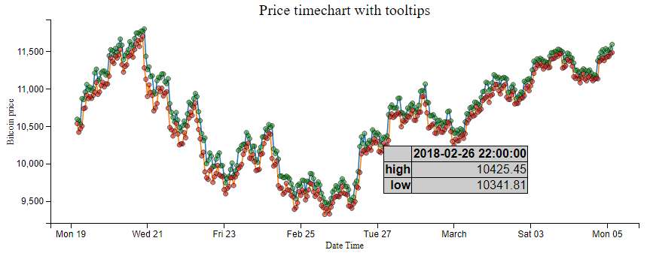
Created price timechart with the interactive tooltip
Hovering shows the data information consisting time, high and low price at that time.
At the weekends and on the Monday price tends to go down.
Night time from 9pm-12pm & at early morning price tends to move more comparing to other hours.
The price went down mostly from February 23 to February 26.
Bitcoin Price Analysis

Slide 18
Results

Slide 19
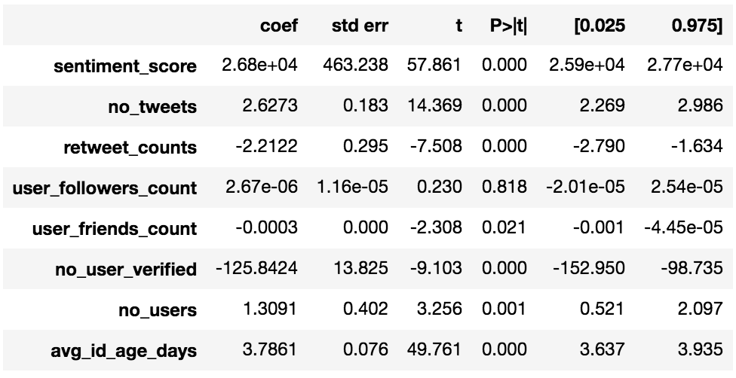
OLS Regression analysis
user_followers_count does not have any statistically significant effect on price (p-values > .05)
all the other predictors have statistically significant effect on price (p-values < .05)
sentiment_score has a very high positive effect on the price keeping other variables as constant. - no_user_verified has negative effect on price keeping other factors as constant.

Slide 20
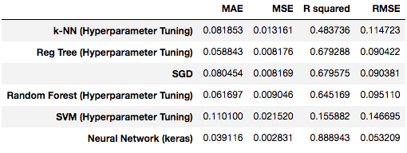
On reviewing the results, the Neural Network model was found to have the best performance
Neural Network had the highest R squarred value (88.89%) and minimum errors
Prediction Model Comparison

Slide 21
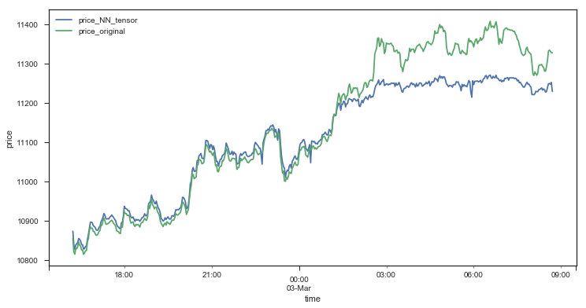
Predicted vs Real Price
Created price timechart with the interactive tooltip
Hovering shows the data information consisting time, high and low price at that time.
At the weekends and on the Monday price tends to go down.
Night time from 9pm to 12pm and at early morning price tends to move more comparing to other hours.
The price went down mostly from February 23 to February 26.

Slide 22
Conclusion
Sentiment is highly correlated with the price of bitcoin.
For a given time range, the number of verified users posting tweets (related to crypto currency) has a negative impact on the price of bitcoin.
The average age of the twitter ID was found to be statistically significant to the price of bitcoin.
For a specific time range (eg 2 minutes) the number tweets was found to be having a statistically significant (positive) effect on the price of bitcoin.
From visualization of location distribution we determined that 60% of the tweets came from USA followed by UK and India.
Lesser price fluctuations were observed during weekends

Slide 23
Conclusion(ctd)
Among all the 6 prediction models that we have derived, the neural network (keras) model was found to have the best performance with
R2 value of 88.89%.
Using our best model (neural network) it is possible to do a price prediction with reasonable accuracy which can help the investors to make insightful decision regarding bitcoin trading.
Based on location distribution visualization it is apparent that crypto currency is mainly used in united states and crypto-currency is fairly a new term for many of the asian countries. Therefore, other countries needs to be made aware about this new source of business transaction.

Slide 24

Thank You

